Slide 1

Mental health on students
By: Anh huynh
Boubacar Traoré

Slide 2
- Introduction of database - Examine the dataset for the issues - Process of cleaning database - Develop the charts - Challenges - Q & A
Table of content

Slide 3
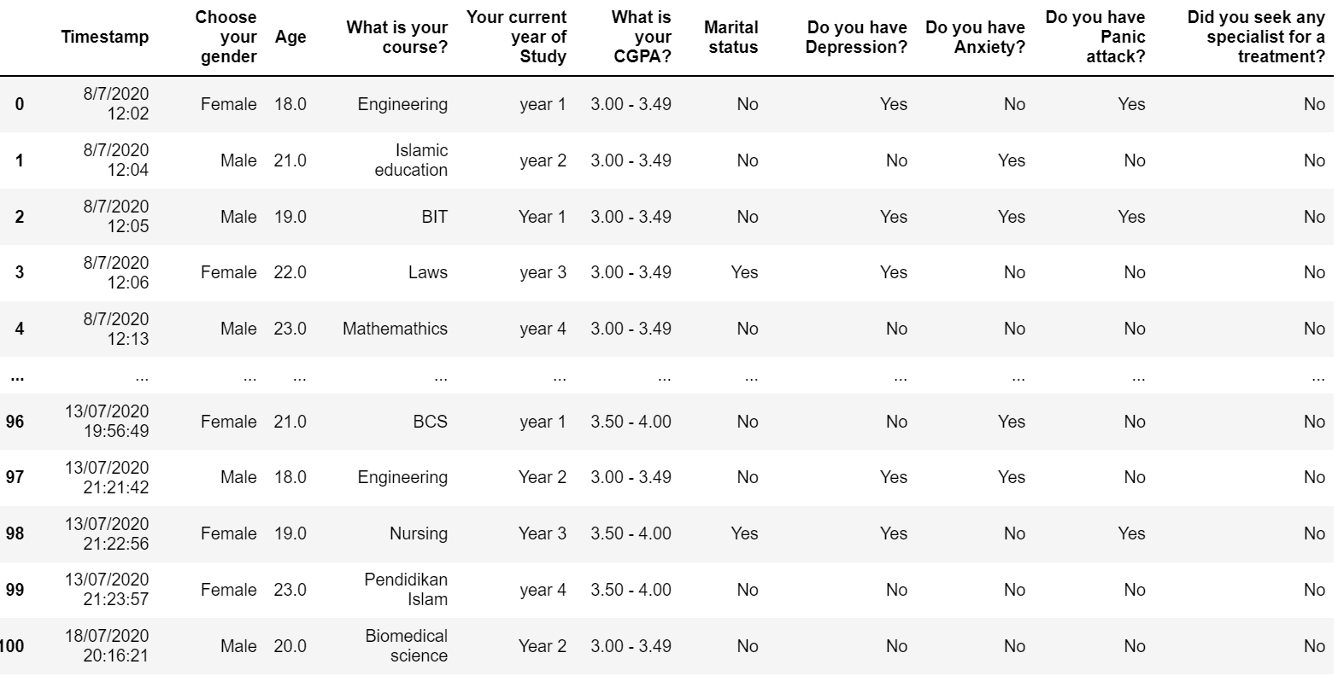

Slide 4
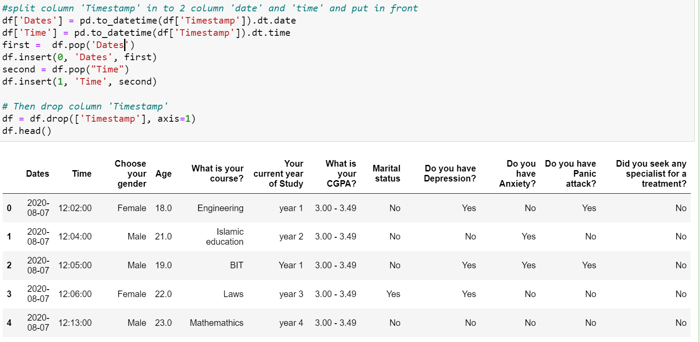

Slide 5
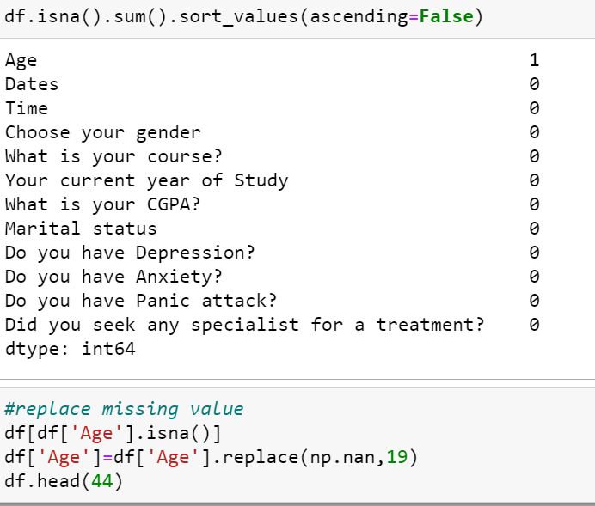
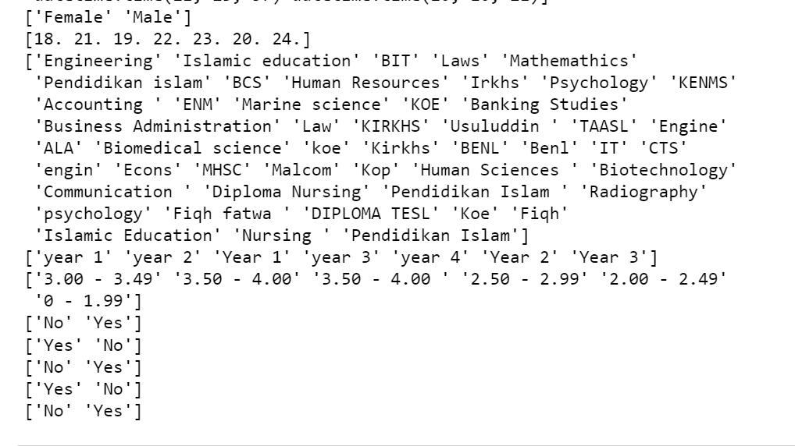

Slide 6
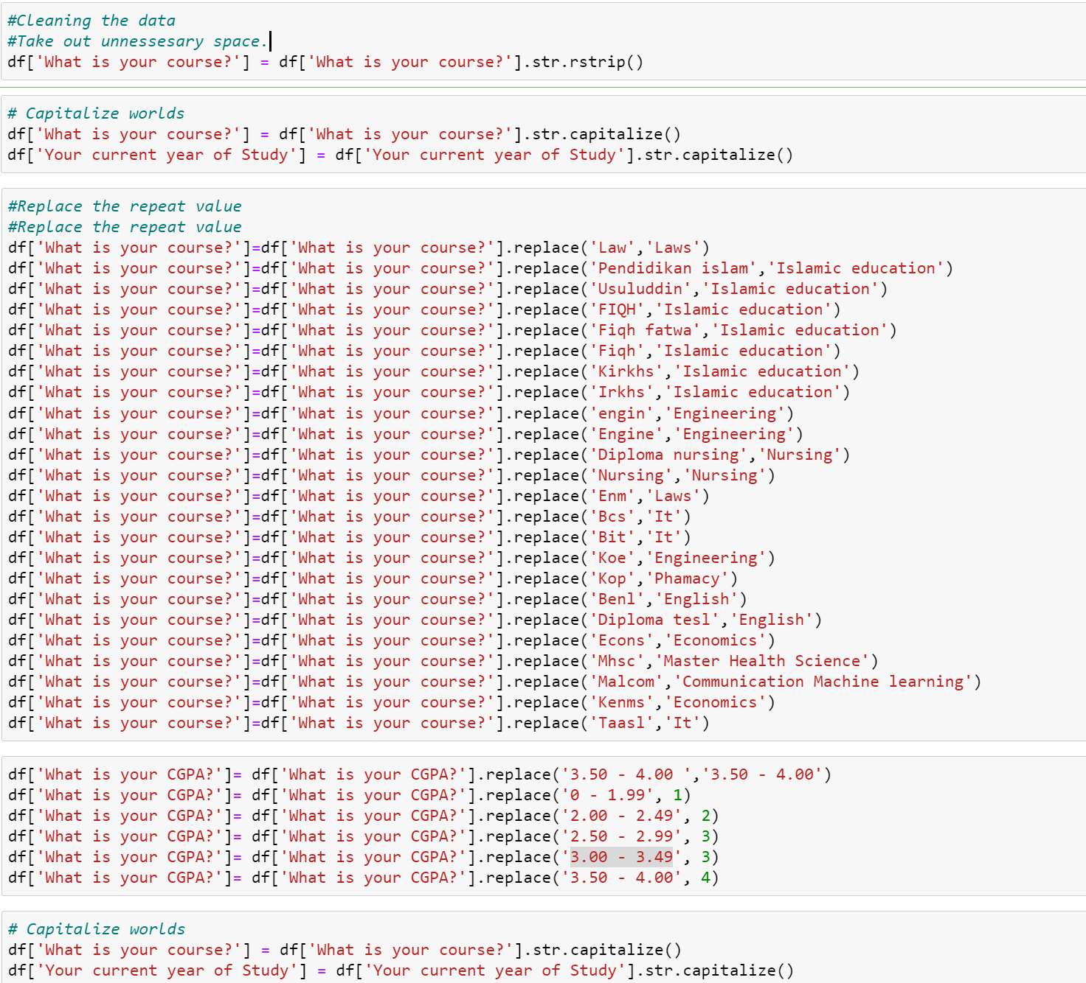

Slide 7
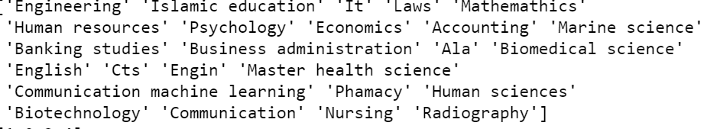
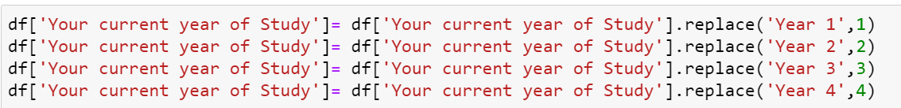
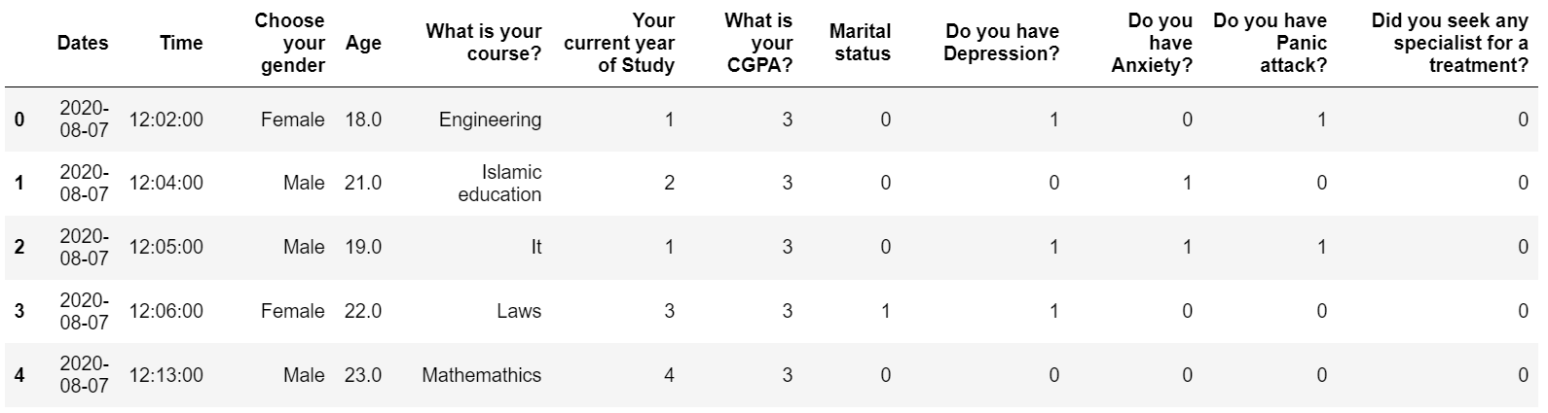

Slide 8


Slide 9


